Slide 1
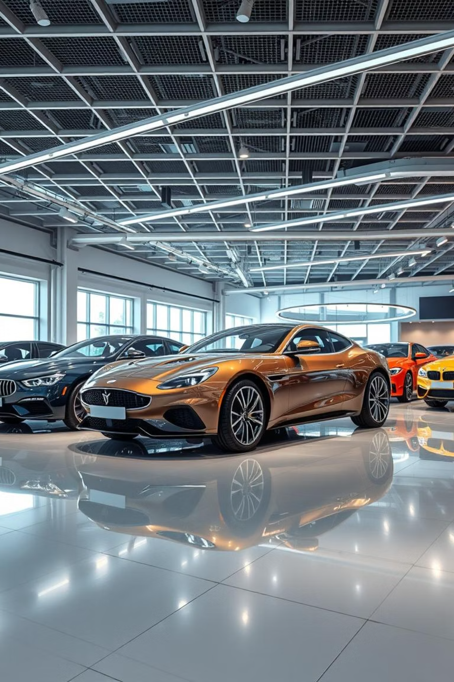
Car Sales Dashboard Report
Analyzing and visualizing car sales data to identify key patterns and trends.

Slide 2

Overview
Purpose and Data Foundation
This dashboard provides a comprehensive analysis of car sales data, offering critical insights for sales managers and analysts. It leverages Power BI to transform raw sales figures into actionable intelligence, highlighting performance across different years, makes, and sellers.
Data Source: task3.xlsx
Contains detailed information on car make, model, year, seller, selling price, and odometer readings. Data was meticulously loaded and cleaned within Power BI to ensure accuracy and readiness for in-depth analysis.

Slide 3
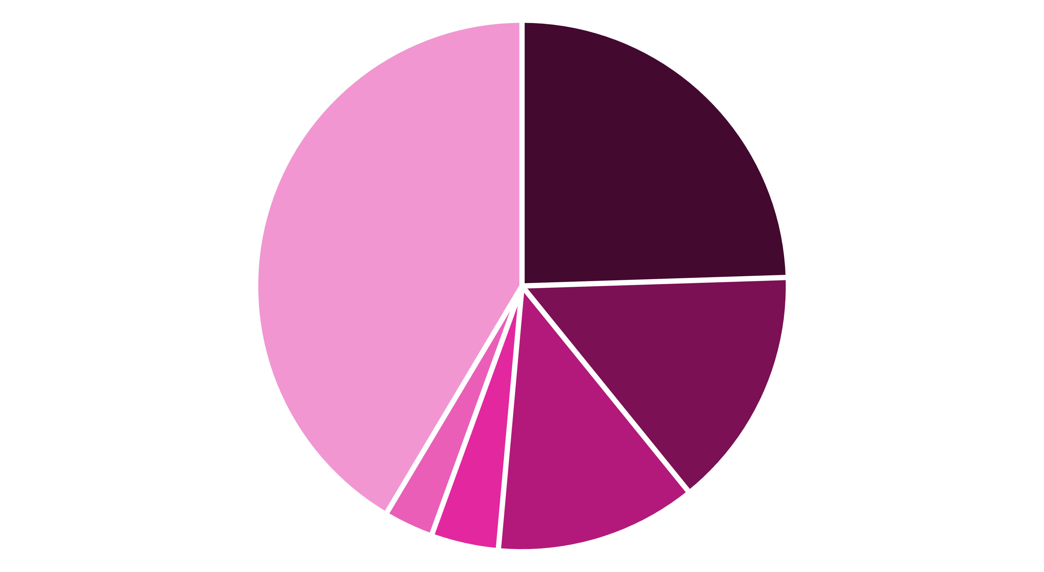
Key Performance Indicators & Brand Dominance
₹616K
₹838K
₹5M
Acura Sales
Audi Sales
BMW Sales
Total selling price for Acura models.
Total selling price for Audi models.
Total selling price for BMW, demonstrating significant market presence.
BMW
Infiniti
Nissan
Audi
Acura
Other
BMW dominates the market share with approximately 24.17% of the total selling price, followed by Infiniti and Nissan. This indicates a strong preference or higher sales volume for these premium and popular brands.

Slide 4
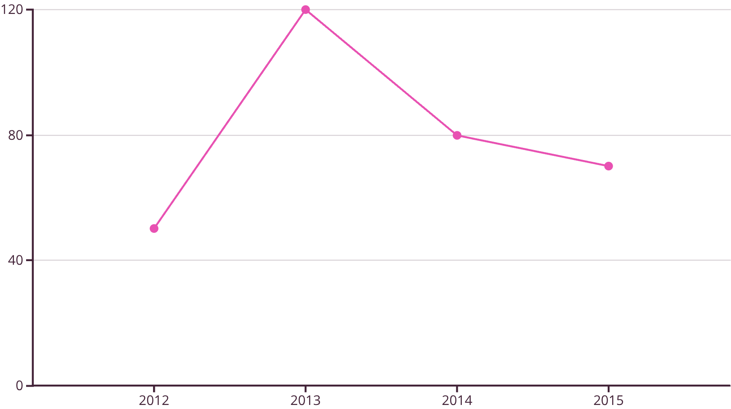
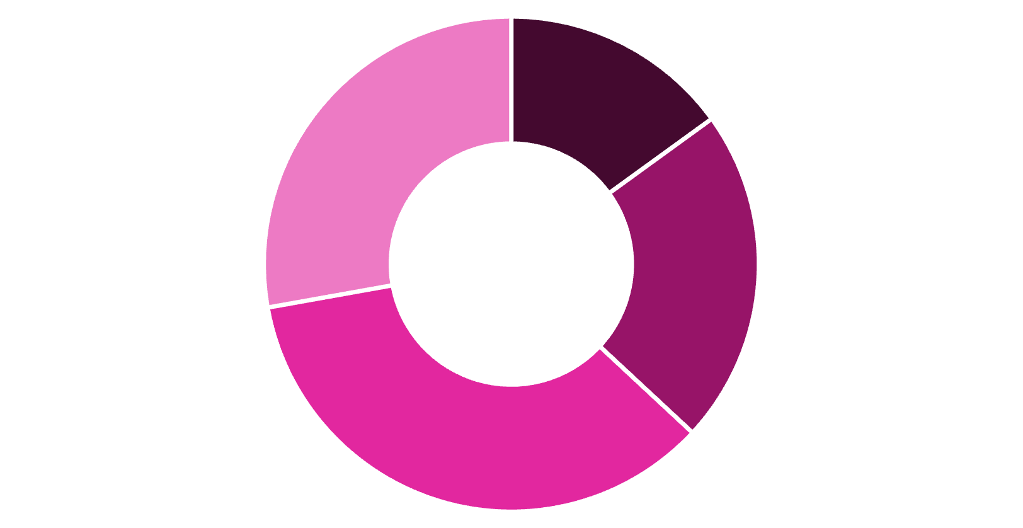
Model and Price Trends Over Time
2012
2013
2014
2015
The line chart illustrates the count of models across different years, revealing a peak in 2013 with the highest number of models recorded. This could indicate a strategic focus on expanding product offerings in that particular year.
The donut chart displays the average selling price by year, highlighting a significant peak in 2014. This suggests factors such as new model releases or market demand influenced higher pricing during that period.

Slide 5
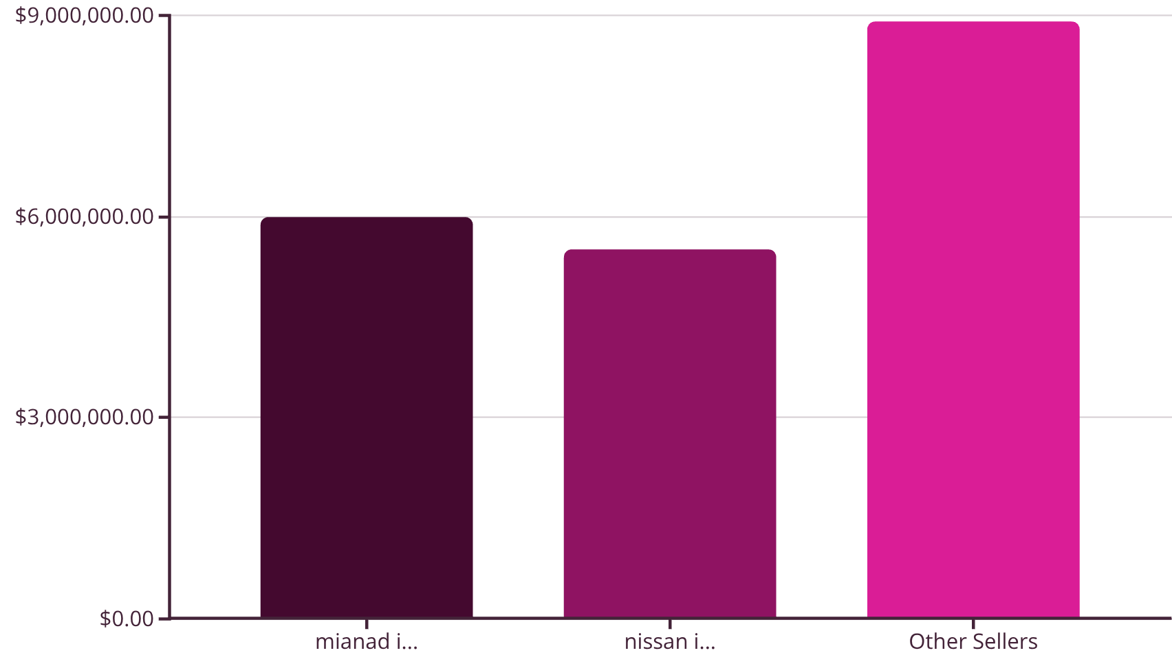
Seller Performance and Detailed Sales Breakdown
Total Sales Across All Categories: ₹20,419,202
The table provides a detailed breakdown of selling prices for each car make by year, allowing for granular analysis of performance metrics and identification of specific trends within segments.
Year
Make
Selling Price
Interactive Features
2013
BMW
₹1,250,000
Slicers: Year, Make, Seller
2014
Infiniti
₹900,000
Drill-down capabilities
The bar chart compares sellers based on their total sales value, showing that "mianad i..." and "nissan i..." are the top performers. This indicates sales concentration among a few key sellers, which might warrant further analysis into their strategies.
2015
Nissan
₹750,000
Dynamic filtering
The dashboard includes interactive slicers that enable users to filter data by Year, Make, and Seller, allowing for dynamic exploration and deeper insights into specific data views. This enhances user flexibility and supports targeted decision-making.

Slide 6
Key Takeaways & Strategic Next Steps
1
2
BMW's Market Leadership
2013: Peak Model Year
BMW is consistently the top-performing brand in sales value. Focus on understanding and replicating the success factors driving BMW sales, such as marketing strategies and customer demographics.
The year 2013 had the highest number of models. Investigate the factors contributing to this peak and consider if similar product expansion strategies could be beneficial in future years.
3
4
Seller Concentration
Dynamic Pricing by Year
Sales are heavily concentrated among a few major sellers. Analyze the best practices of these top sellers ("mianad i..." and "nissan i...") to identify strategies that can be disseminated to other sales teams.
Average selling prices vary significantly by year. This suggests opportunities for dynamic pricing models or targeted promotions based on annual market conditions and demand fluctuations.
This Power BI dashboard offers a powerful tool for strategic decision-making in car sales, providing clear visibility into market trends and performance drivers.

